Slide 1
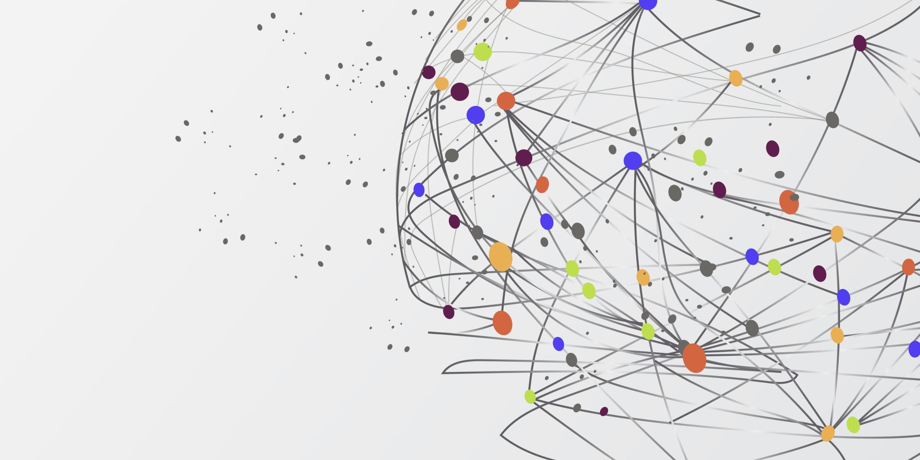
Clinical Data Analysis and Text Mining
Lokesh Kumar Patnaik
08/25/2024

Slide 2
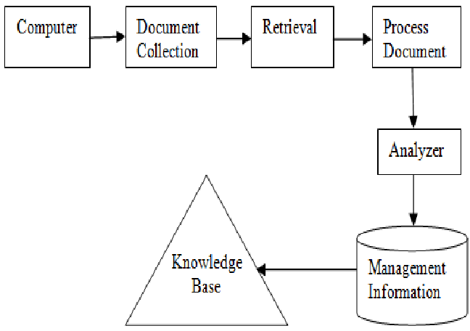
Introduction
Objective: To analyze and extract valuable insights from clinical data
using text mining and topic modeling techniques.
Scope: Focus on medical conditions and test results from unstructured text data.

Slide 3
Goals
Text Extraction: Identify and extract key entities from medical conditions and test results.
Topic Modeling: Uncover underlying themes in the data using Latent Dirichlet Allocation (LDA).
Data Analysis: Perform statistical analysis on numerical data like billing amounts.
Image: Use an infographic or diagram to represent goals.

Slide 4
Dataset
Name | Age | Gender | Blood Type | Medical Condition | Date of Admission | Doctor | Hospital | Insurance Provider | Billing Amount | Room Number | Admission Type | Discharge Date | Medication | Test Results
Bobby JacksOn | 30 | Male | B- | Cancer | 1/31/2024 | Matthew Smith | Sons and Miller | Blue Cross | 18856.281305978155 | 328 | Urgent | 2/2/2024 | Paracetamol | Normal
LesLie TErRy | 62 | Male | A+ | Obesity | 8/20/2019 | Samantha Davies | Kim Inc | Medicare | 33643.327286577885 | 265 | Emergency | 8/26/2019 | Ibuprofen | Inconclusive
DaNnY sMitH | 76 | Female | A- | Obesity | 9/22/2022 | Tiffany Mitchell | Cook PLC | Aetna | 27955.096078842456 | 205 | Emergency | 10/7/2022 | Aspirin | Normal
andrEw waTtS | 28 | Female | O+ | Diabetes | 11/18/2020 | Kevin Wells | Hernandez Rogers and Vang, | Medicare | 37909.78240987528 | 450 | Elective | 12/18/2020 | Ibuprofen | Abnormal
adrIENNE bEll | 43 | Female | AB+ | Cancer | 9/19/2022 | Kathleen Hanna | White-White | Aetna | 14238.317813937623 | 458 | Urgent | 10/9/2022 | Penicillin | Abnormal

Slide 5
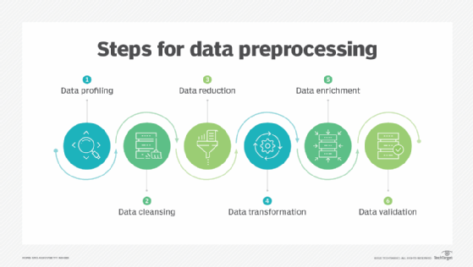
Data Preprocessing
Text Preprocessing: Extract entities from Medical Condition and Test Results Columns..
Techniques Used: spaCy for entity recognition.
Output: Cleaned and processed text data for further analysis.

Slide 6
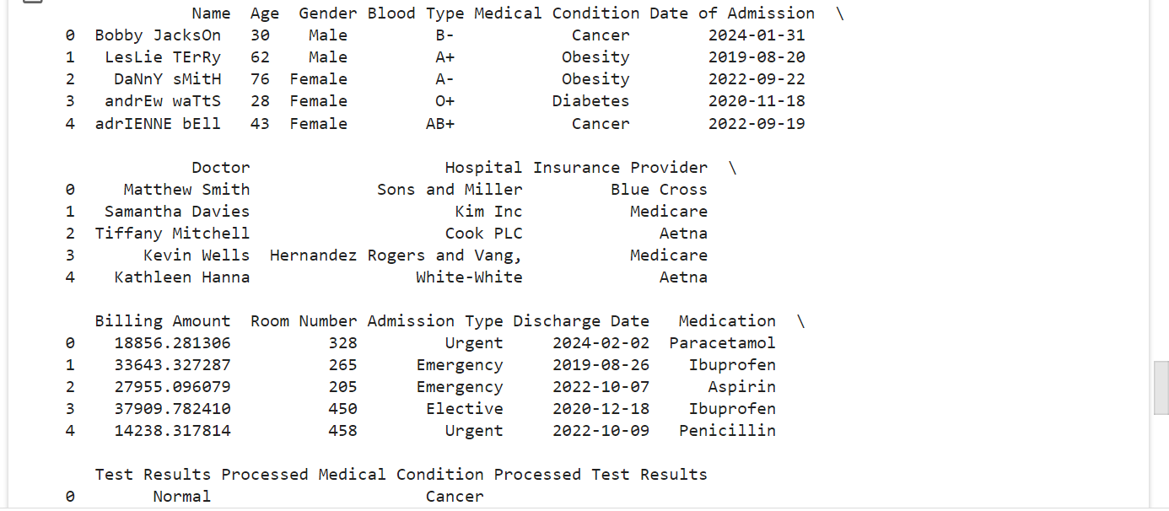
Topic Modeling
Approach: Latent Dirichlet Allocation (LDA)
Process:
Combine Processed Medical Condition and Processed Test Results. Vectorize text using CountVectorizer.
Extract topics using LDA.

Slide 7
Data Analysis
Billing Amount
18856.281305978155
33643.327286577885
27955.096078842456
37909.78240987528
14238.317813937623
48145.11095104189
19580.87234486093
45820.46272159459
50119.222791548505
19784.63106221073
12576.795609050234
7999.586879604188
43282.28335770435
33207.706633729606
40701.599227308754
12263.357425021362
24499.847903736576
17440.465444124675
18843.02301783416
Data Overview: Print data and preprocessed data heads.
Scaling Numerical Data: Normalize Billing Amount and StandardScaler
Insights: Example of scaled billing amounts for better comparison

Slide 8
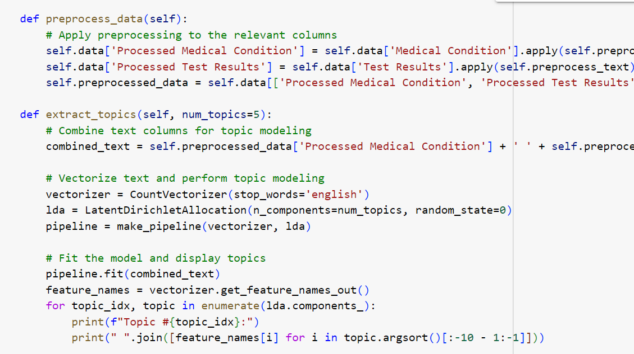
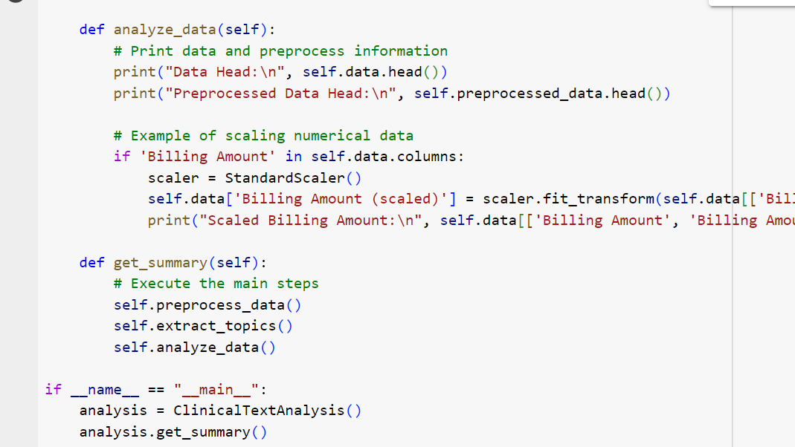
Code
Preprocessing: Used spaCy to extract entities from text.
Topic Modeling: Used LDA to find topics in combined text data.
Data Scaling: Normalize billing amounts for analysis.

Slide 9
Proof of Concept
Top Modeling Results:
Topic #0: cancer
Topic #1: cancer
Topic #2: cancer
Topic #3: cancer
Topic #4: cancer

Slide 10
Next Steps and Recommendations
Refinement of Topic Modeling:
Recommendation: The topic modeling results showed a dominance of the term "cancer" across all topics. To improve the results:
Enhance Preprocessing: To refine the data further, apply more advanced text preprocessing techniques, such as stemming and lemmatization.
Expand Dataset: Include more diverse text data to cover a broader range of topics and improve model accuracy.
Tune Parameters: Experiment with different parameters for the LDA model, such as the number of topics or regularization techniques.

Slide 11
Conclusion
Summary: Successfully demonstrated text extraction and topic modeling.
Implications: Provides insights into medical conditions and test results, helping in better understanding of clinical data.
Future Work: Extend analysis to other columns, integrate additional data sources.

Slide 12

Questions and Discussion
You can always reach me out at Here

